Slide 1

Introduction to Probability and Statistics
Twelfth Edition
Robert J. Beaver • Barbara M. Beaver • William Mendenhall
Presentation designed and written by:
Barbara M. Beaver

Slide 2
Introduction to Probability and Statistics
Twelfth Edition
Chapter 14
Analysis of Categorical Data
Some graphic screen captures from Seeing Statistics ®
Some images © 2001-(current year) www.arttoday.com

Slide 3
Introduction
m
m
m
m
m
m
Many experiments result in measurements that are qualitative or categorical rather than quantitative.
  People classified by ethnic origin
  Cars classified by color
  M&M®s classified by type (plain or peanut)
These data sets have the characteristics of a multinomial experiment.

Slide 4
The Multinomial Experiment
m
m
m
m
m
m
The experiment consists of n identical trials.
Each trial results in one of k categories.
The probability that the outcome falls into a particular category i on a single trial is p_{i} and remains constant from trial to trial. The sum of all k probabilities, p₁+p₂ +…+ p_{k} = 1.
The trials are independent.
We are interested in the number of outcomes in each category, O_{1,} O_{2 ,}… O_{k} with O₁ + O₂ +… + O_{k} = n.

Slide 5
The Binomial Experiment
m
m
m
m
m
m
A special case of the multinomial experiment with k = 2.
Categories 1 and 2: success and failure
p₁ and p₂: p and q
O₁ and O₂: x and n-x
We made inferences about p
(and q = 1 - p)
In the multinomial experiment, we make inferences about all the probabilities, p₁, p₂, p₃ …p_{k}.

Slide 6
Pearson’s Chi-Square Statistic
m
m
m
m
m
m
We have some preconceived idea about the values of the p_{i} and want to use sample information to see if we are correct.
The expected number of times that outcome i will occur is E_{i} = np_{i}. If the observed cell counts, O_{i}, are too far from what we hypothesize under H₀, the more likely it is that H₀ should be rejected.

Slide 7
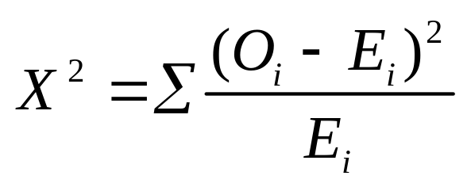
Pearson’s Chi-Square Statistic
m
m
m
m
m
m
We use the Pearson chi-square statistic:
When H₀ is true, the differences O-E will be small, but large when H₀ is false.
Look for large values of X² based on the chi-square distribution with a particular number of degrees of freedom.

Slide 8
Degrees of Freedom
m
m
m
m
m
m
These will be different depending on the application.
Start with the number of categories or cells in the experiment.
Subtract 1df for each linear restriction on the cell probabilities. (You always lose 1 df since p₁+p₂ +…+ p_{k} = 1.)
Subtract 1 df for every population parameter you have to estimate to calculate or estimate E_{i}.

Slide 9

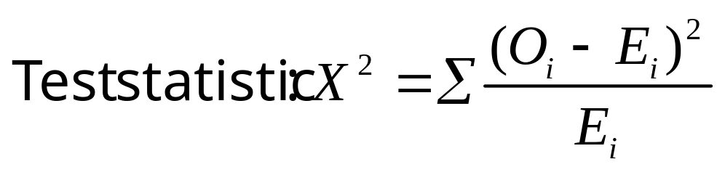
The Goodness of Fit Test
The simplest of the applications.
A single categorical variable is measured, and exact numerical values are specified for each of the p_{i}.
Expected cell counts are E_{i} = np_{i}
Degrees of freedom: df = k-1

Slide 10
Example
Toss a die 300 times with the following results. Is the die fair or biased?
Upper Face | 1 | 2 | 3 | 4 | 5 | 6
Number of times | 50 | 39 | 45 | 62 | 61 | 43
A multinomial experiment with k = 6 and O₁ to O₆ given in the table.
We test:
H₀: p₁= 1/6; p₂ = 1/6;…p₆ = 1/6 (die is fair)
H_{a}: at least one p_{i} is different from 1/6 (die is biased)

Slide 11
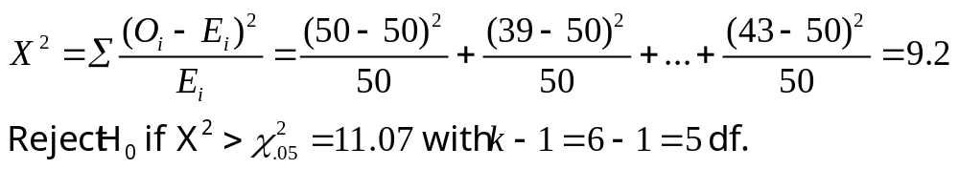
Example
Calculate the expected cell counts:
E_{i} = np_{i} = 300(1/6) = 50
Upper Face | 1 | 2 | 3 | 4 | 5 | 6
O_{i} | 50 | 39 | 45 | 62 | 61 | 43
E_{i} | 50 | 50 | 50 | 50 | 50 | 50
Do not reject H₀. There is insufficient evidence to indicate that the die is biased.
Test statistic and rejection region:

Slide 12
Some Notes
m
m
m
m
m
m
The test statistic, X² has only an
approximate chi-square distribution.
For the approximation to be accurate, statisticians recommend E_{i} ≥ 5 for all cells.
Goodness of fit tests are different from previous tests since the experimenter uses H₀ for the model he thinks is true.
H₀: model is correct (as specified)
H_{a}: model is not correct
Be careful not to accept H₀ (say the model is correct) without reporting β.

Slide 13

Contingency Tables: A Two-Way Classification
The experimenter measures two qualitative variables to generate bivariate data.
  Gender and colorblindness
  Age and opinion
  Professorial rank and type of university
Summarize the data by counting the observed number of outcomes in each of the intersections of category levels in a contingency table.

Slide 14
r x c Contingency Table
The contingency table has r rows and c columns—rc total cells.
 | 1 | 2 | … | c
1 | O₁₁ | O₁₂ | … | O_{1c}
2 | O₂₁ | O₂₂ | … | O_{2c}
… | … | … | … | ….
r | O_{r1} | O_{r2} | … | O_{rc}
Does the distribution of measurements in the various categories for variable 1 depend on which category of variable 2 is being observed?
If not, the variables are independent.
We study the relationship between the two variables. Is one method of classification contingent or dependent on the other?

Slide 15
Chi-Square Test of Independence
H₀: classifications are independent
H_{a}: classifications are dependent
Observed cell counts are O_{ij} for row i and column j.
Expected cell counts are E_{ij} = np_{ij}
  If H₀ is true and the classifications are independent,
  p_{ij} = p_{i}p_{j} = P(falling in row i)P(falling in row j)

Slide 16
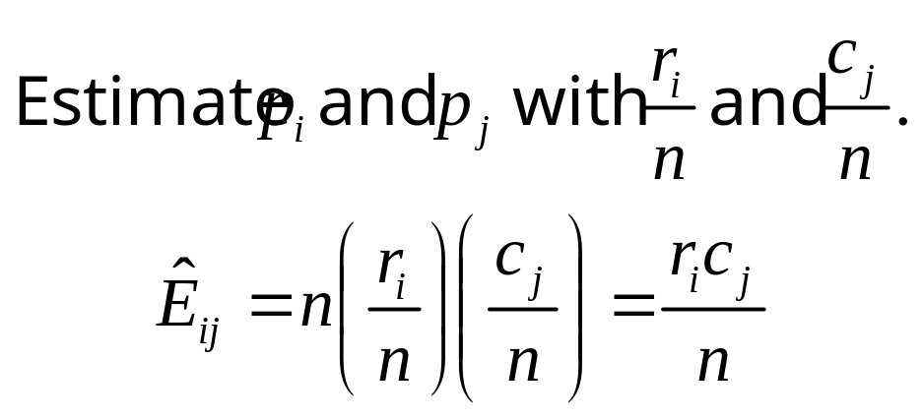
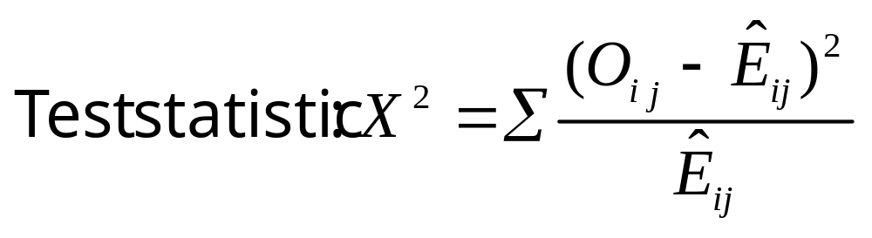
Chi-Square Test of Independence
The test statistic has an approximate chi-square distribution with df = (r-1)(c-1).

Slide 17
Example
Furniture defects are classified according to type of defect and shift on which it was made.
 | Shift
Type | 1 | 2 | 3 | Total
A | 15 | 26 | 33 | 74
B | 21 | 31 | 17 | 69
C | 45 | 34 | 49 | 128
D | 13 | 5 | 20 | 38
Total | 94 | 96 | 119 | 309
Do the data present sufficient evidence to indicate that the type of furniture defect varies with the shift during which the piece of furniture is produced? Test at the 1% level of significance.
H₀: type of defect is independent of shift
H_{a}: type of defect depends on the shift

Slide 18
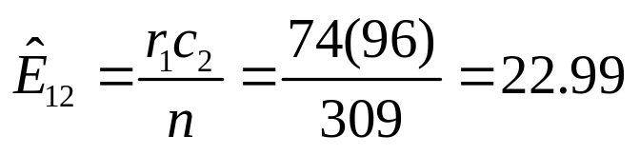
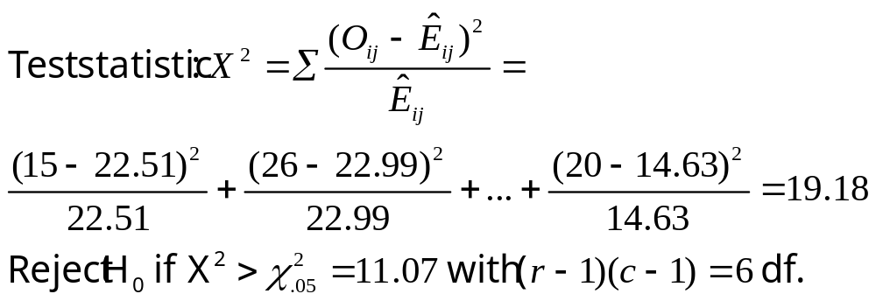
The Furniture Problem
Calculate the expected cell counts. For example:
MY
APPLET
Chi-Square Test: 1, 2, 3
Expected counts are printed below observed counts
Chi-Square contributions are printed below expected counts
1 2 3 Total
1 15 26 33 74
22.51 22.99 28.50
2.506 0.394 0.711
2 21 31 17 69
20.99 21.44 26.57
0.000 4.266 3.449
3 45 34 49 128
38.94 39.77 49.29
0.944 0.836 0.002
4 13 5 20 38
11.56 11.81 14.63
0.179 3.923 1.967
Total 94 96 119 309
Chi-Sq = 19.178, DF = 6, P-Value = 0.004
Reject H₀. There is sufficient evidence to indicate that the proportion of defect types vary from shift to shift.

Slide 19

Comparing Multinomial Populations
Sometimes researchers design an experiment so that the number of experimental units falling in one set of categories is fixed in advance.
Example: An experimenter selects 900 patients who have been treated for flu prevention. She selects 300 from each of three types—no vaccine, one shot, and two shots.
The column totals have been fixed in advance!
 | No Vaccine | One Shot | Two Shots | Total
Flu |  |  |  | r₁
No Flu |  |  |  | r₂
Total | 300 | 300 | 300 | n = 900

Slide 20
Comparing Multinomial Populations
Each of the c columns (or r rows) whose totals have been fixed in advance is actually a single multinomial experiment.
The chi-square test of independence with (r-1)(c-1) df is equivalent to a test of the equality of c (or r) multinomial populations.
Three binomial populations—no vaccine, one shot and two shots.
Is the probability of getting the flu independent of the type of flu prevention used?
 | No Vaccine | One Shot | Two Shots | Total
Flu |  |  |  | r₁
No Flu |  |  |  | r₂
Total | 300 | 300 | 300 | n = 900

Slide 21

Example
Random samples of 200 voters in each of four wards were surveyed and asked if they favor candidate A in a local election.
MY
APPLET
 | Ward
 | 1 | 2 | 3 | 4 | Total
Favor A | 76 | 53 | 59 | 48 | 236
Do not favor A | 124 | 147 | 141 | 152 | 564
Total | 200 | 200 | 200 | 200 | 800
Do the data present sufficient evidence to indicate that the the fraction of voters favoring candidate A differs in the four wards?
H₀: p₁ = p₂ = p₃ = p₄
where p_{i} = fraction favoring A in each of the four wards
H₀: fraction favoring A is independent of ward
H_{a}: fraction favoring A depends on the ward

Slide 22
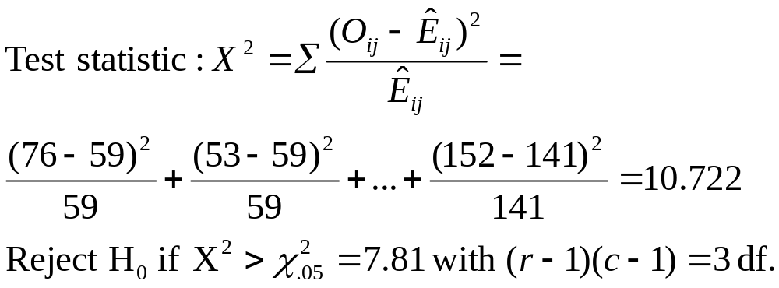
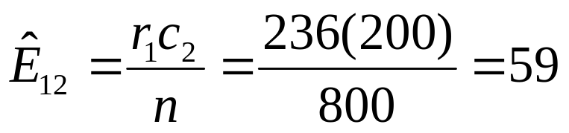
The Voter Problem
MY
APPLET
Calculate the expected cell counts. For example:
Chi-Square Test: 1, 2, 3, 4
Expected counts are printed below observed counts
Chi-Square contributions are printed below expected counts
1 2 3 4 Total
1 76 53 59 48 236
59.00 59.00 59.00 59.00
4.898 0.610 0.000 2.051
2 124 147 141 152 564
141.00 141.00 141.00 141.00
2.050 0.255 0.000 0.858
Total 200 200 200 200 800
Chi-Sq = 10.722, DF = 3, P-Value = 0.013
Reject H₀. There is sufficient evidence to indicate that the fraction of voters favoring A varies from ward to ward.

Slide 23
The Voter Problem
Since we know that there are differences among the four wards, what are the nature of the differences?
Look at the proportions in favor of candidate A in the four wards.
Ward | 1 | 2 | 3 | 4
Favor A | 76/200=.38 | 53/200 = .27 | 59/200 = .30 | 48/200 = .24
Candidate A is doing best in the first ward, and worst in the fourth ward. More importantly, he does not have a majority of the vote in any of the wards!

Slide 24
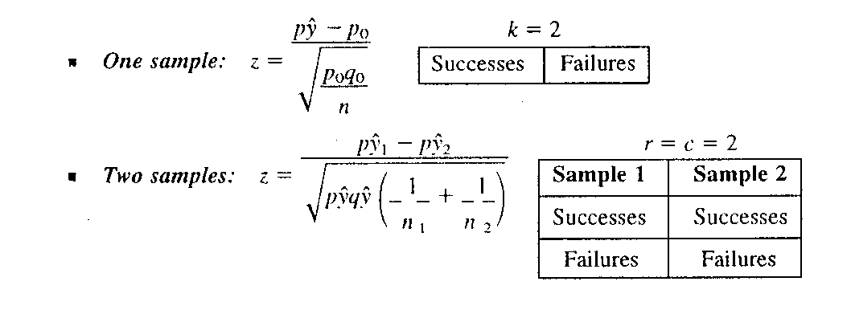
Equivalent Statistical Tests
m
m
m
m
m
m
A multinomial experiment with two categories is a binomial experiment.
The data from two binomial experiments can be displayed as a two-way classification.
There are statistical tests for these two situations based on the statistic of Chapter 9:

Slide 25
Other Applications
m
m
m
m
m
m
Goodness-of-fit tests: It is possible to design a goodness-of-fit test to determine whether data are consistent with data drawn from a particular probability distribution, possibly the normal, binomial, Poisson, or other distributions.
Time-dependent multinomials: The chi square statistic can be used to investigate the rate of change of multinomial proportions over time.

Slide 26
Other Applications
m
m
m
m
m
m
Multidimensional contingency tables: Instead of only two methods of classification, it is possible to investigate a dependence among three or more classifications.
Log-linear models: Complex models can be created in which the logarithm of the cell probability (ln p_{ij}) is some linear function of the row and column probabilities.

Slide 27
Assumptions
m
m
m
m
m
m
Assumptions for Pearson’s Chi-Square:
The cell counts O₁, O₂, …,O_{k} must satisfy the conditions of a multinomial experiment, or a set of multinomial experiments created by fixing either the row or the column totals.
The expected cell counts E₁, E₂, …, E_{k} should equal or exceed five.

Slide 28
Assumptions
m
m
m
m
m
m
When you calculate the expected cell
counts, if you find that one or more is less than five, these options are available to you:
Choose a larger sample size n. The larger the sample size, the closer the chi-square distribution will approximate the distribution of your test statistic X².
It may be possible to combine one or more of the cells with small expected cell counts, thereby satisfying the assumption.

Slide 29
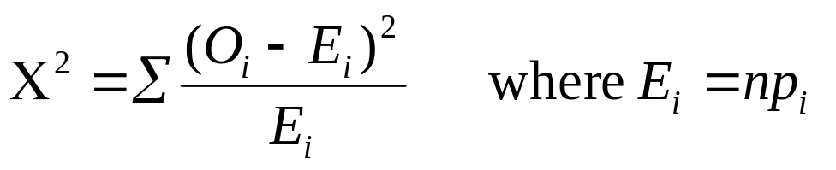
Key Concepts
I. The Multinomial Experiment
1. There are n identical trials, and each outcome falls into one
of k categories.
2. The probability of falling into category i is p_{i} and remains
constant from trial to trial.
3. The trials are independent, Σ p_{i} = 1, and we measure O_{i} , the
number of observations that fall into each of the k categories.
II. Pearson’s Chi-Square Statistic
which has an approximate chi-square distribution with degrees of freedom determined by the application.

Slide 30
Key Concepts
III. The Goodness-of-Fit Test
1. This is a one-way classification with cell probabilities specified in H₀.
2. Use the chi-square statistic with E_{i} = np_{i} calculated with the hypothesized probabilities.
3. d f = k − 1 − (Number of parameters estimated in order to find E_{i})
4. If H₀ is rejected, investigate the nature if the differences using the sampling proportions.

Slide 31
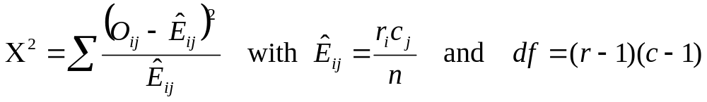
Key Concepts
IV. Contingency Tables
A two-way classification with n observations into r × c cells of a two-way table using two different methods of classification is called a contingency table.
The test for independence of classifications methods uses the chi-square statistic
3. If the null hypothesis of independence of classifications is rejected, investigate the nature of the dependency using conditional proportions within either the rows or columns of the contingency table.

Slide 32
Key Concepts
V. Fixing Row or Column Totals
1. When either the row or column totals are fixed, the test of independence of classifications becomes a test of the homogeneity of cell probabilities for several multinomial experiments.
2. Use the same chi-square statistic as for contingency tables.
3. The large-sample z tests for one and two binomial proportions are special cases of the chi-square statistic.

Slide 33
Key Concepts
VI. Assumptions
1. The cell counts satisfy the conditions of a multinomial experiment, or a set of multinomial experiments with fixed sample sizes.
2. All expected cell counts must equal or exceed five in order that the chi-square approximation is valid.

